Slide 1
bestemshe
Hana Kotinova

Slide 2
Bestemshe – Is a GAME…
Game cathegories:
board game
abstract game
game for 2
mancala game
short game
game with no luck

Slide 3
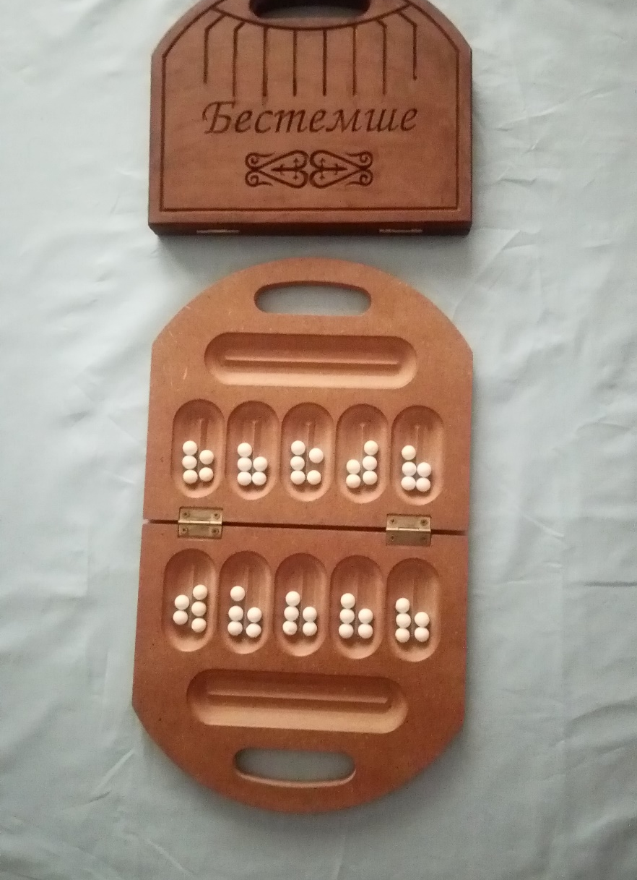
JUST a
BOARD GAME ??
Not only…
It is also the way,
how to learn and train many things

Slide 4
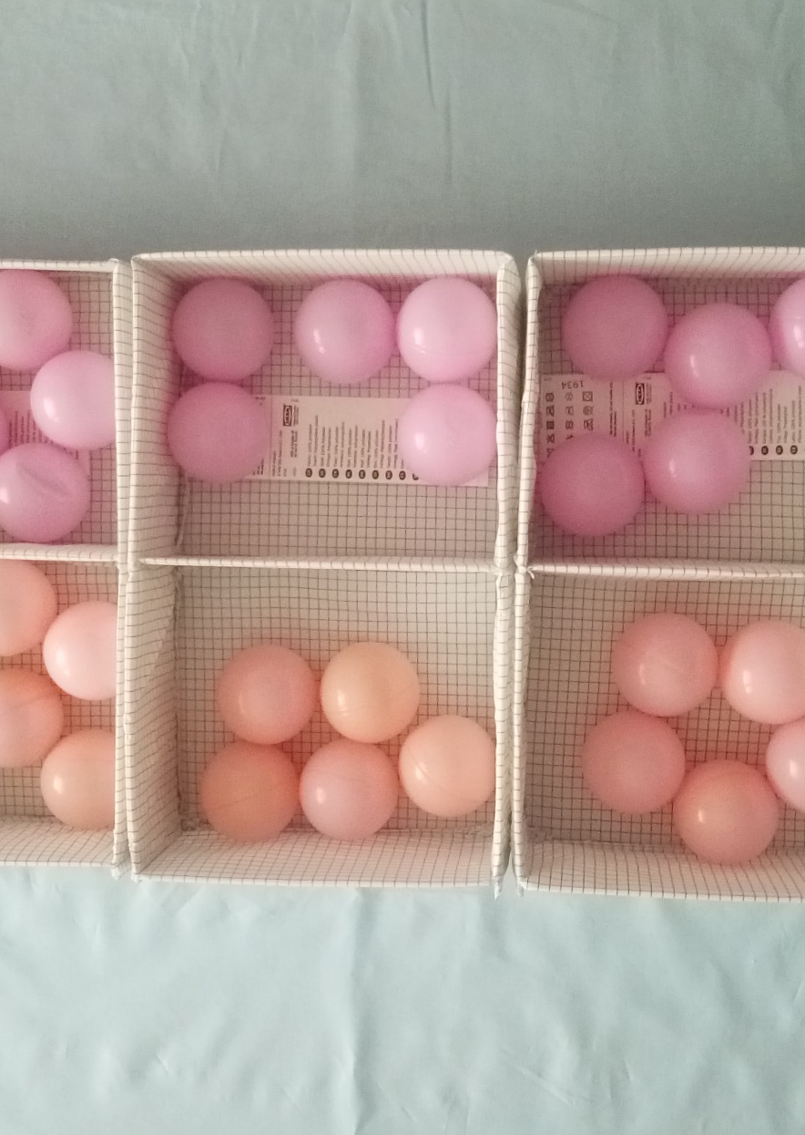
START EARLY,
LEARN EASILY,
LEARN MORE
Activities for age 3+

Slide 5
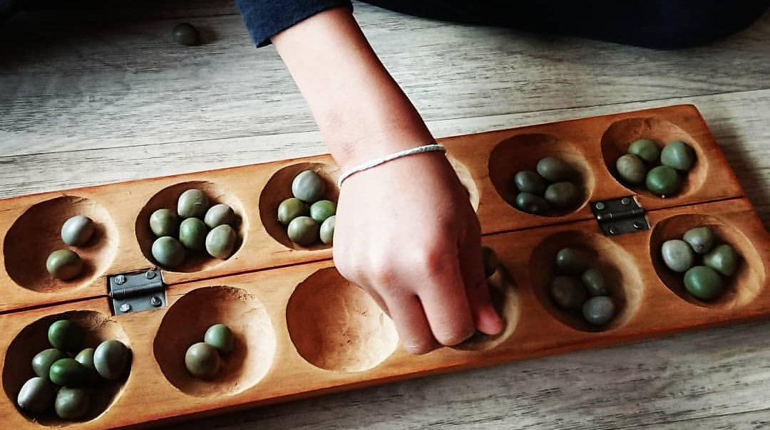
Fine motor skills
… just sowing

Slide 6
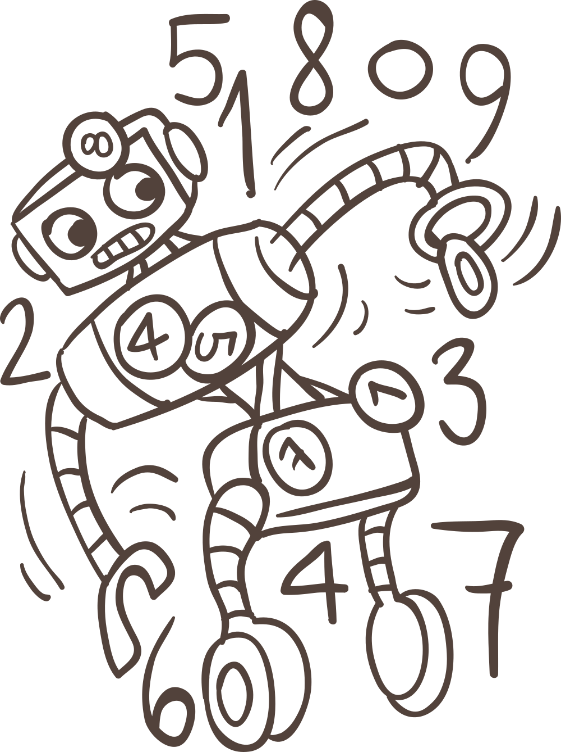
Sow and count 1, 2, 3, …
Counting
row of numbers

Slide 7
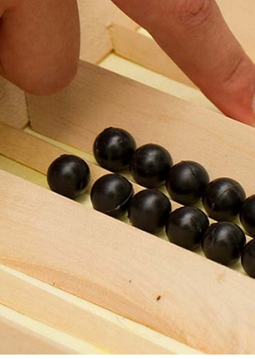
EVEN
AND
ODD

Slide 8

LOGIC

Slide 9

MEMORY

Slide 10
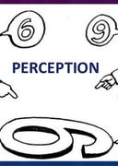
PERCEPTION
…what do you see?

Slide 11

PLANNING

Slide 12

Decision MAKING
… what is the best?

Slide 13
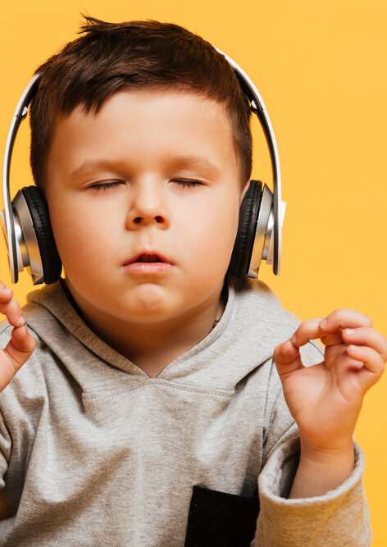
CONCENTRATION

Slide 14
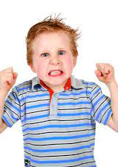
SELF-CONTROL

Slide 15

Learning…
… FROM YOUR OWN MISTAKES

Slide 16
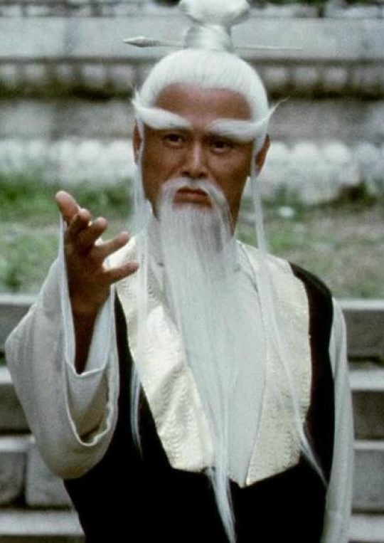
MASTER ALREADY?
Let’s try other things …

Slide 17
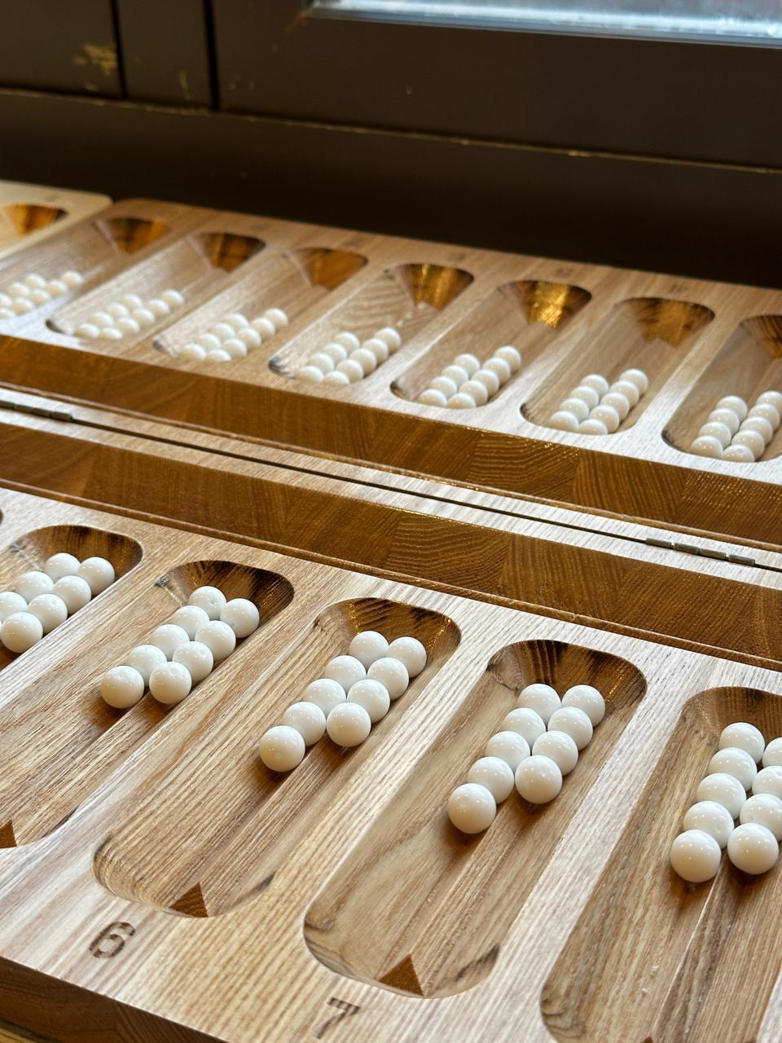
TOGYZQUMALAQ
or …

Slide 18
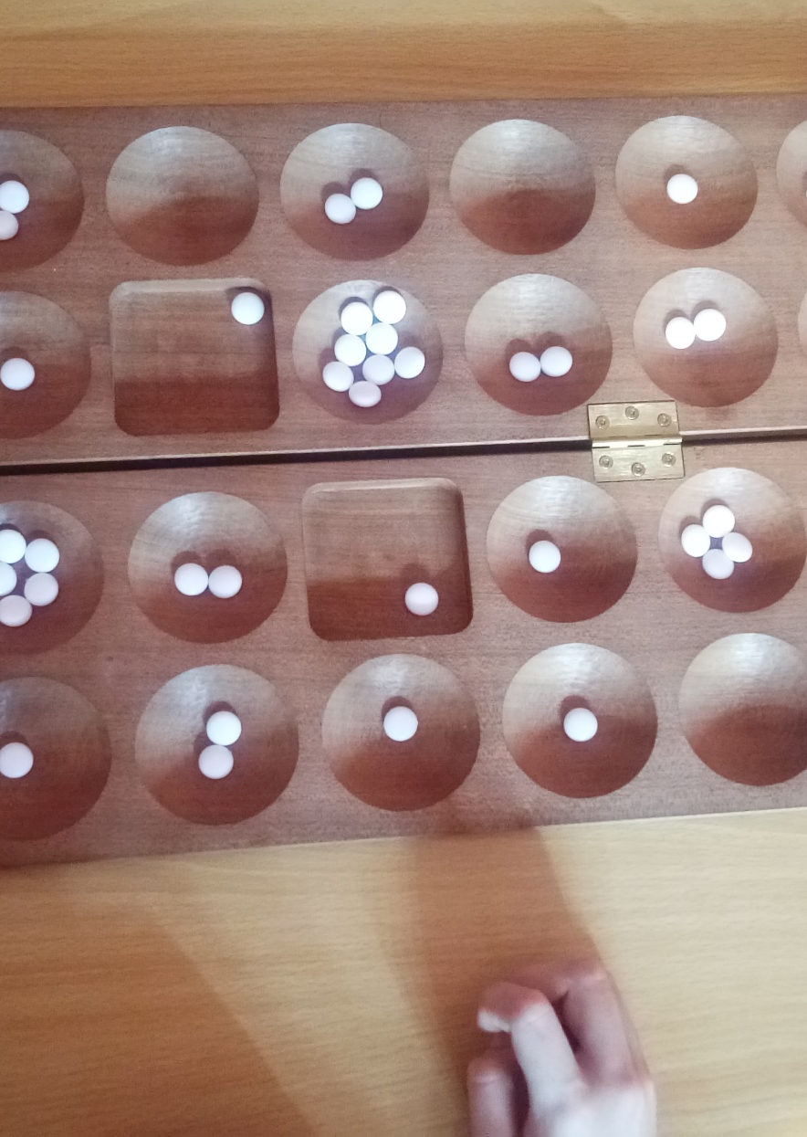
OWARE, MANGALA, BAO
And dozens of other mancala variants
or …

Slide 19
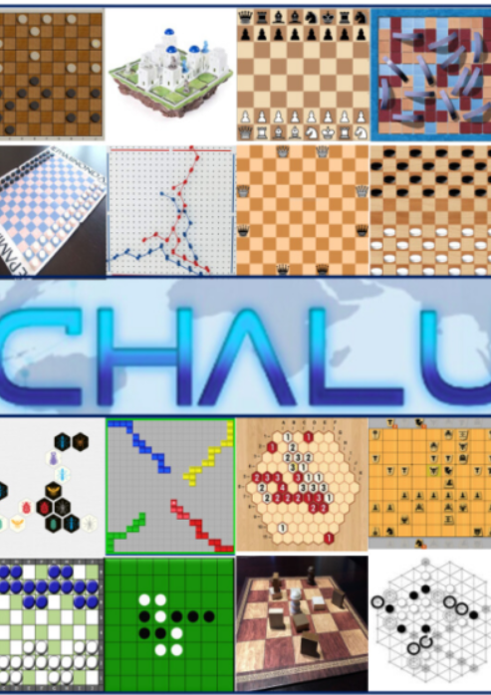
Thousands of abstract games
Everyone has talent to different things…

Slide 20
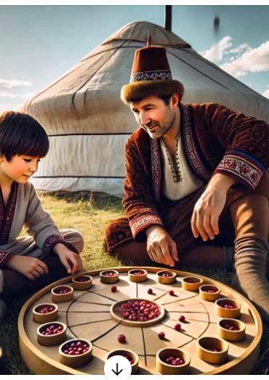
DIDACTICS – how to teach
Variant where you capture if you sow last piece to empty cup (suitable for age 3-5)
Bestemshe (suitable for 5+)
TogyzQumalaQ, Oware, Mangala
Bao

Slide 21

THANK YOU

