Slide 1
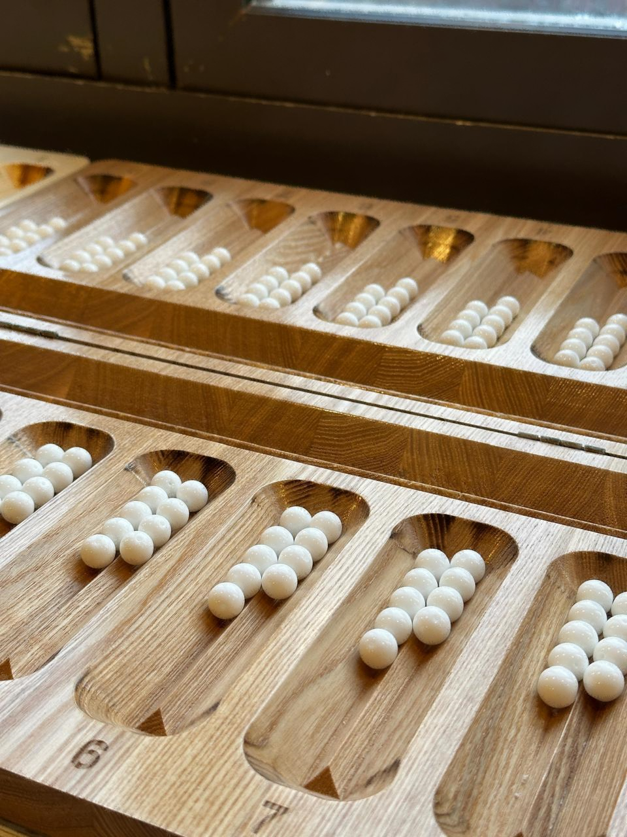
Mathematics in traditional games of nomadic cultures
Hana Kotinová
Viceprezident of World TogyzQumalaQ Federation
World Champion in Mangala 2024

Slide 2
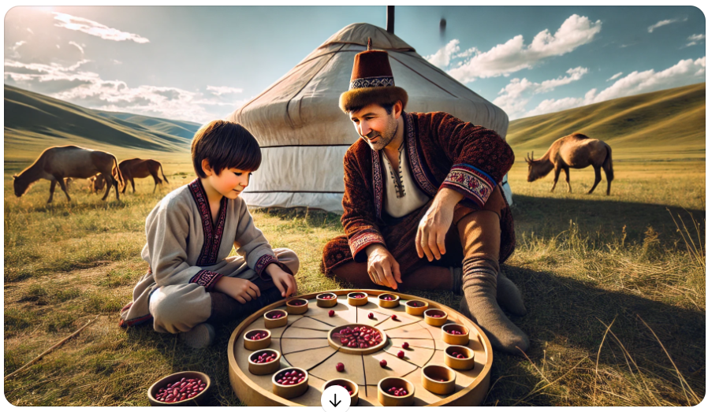
Where
Kazakhstan
Kyrgyzstan
Türkiye

Slide 3
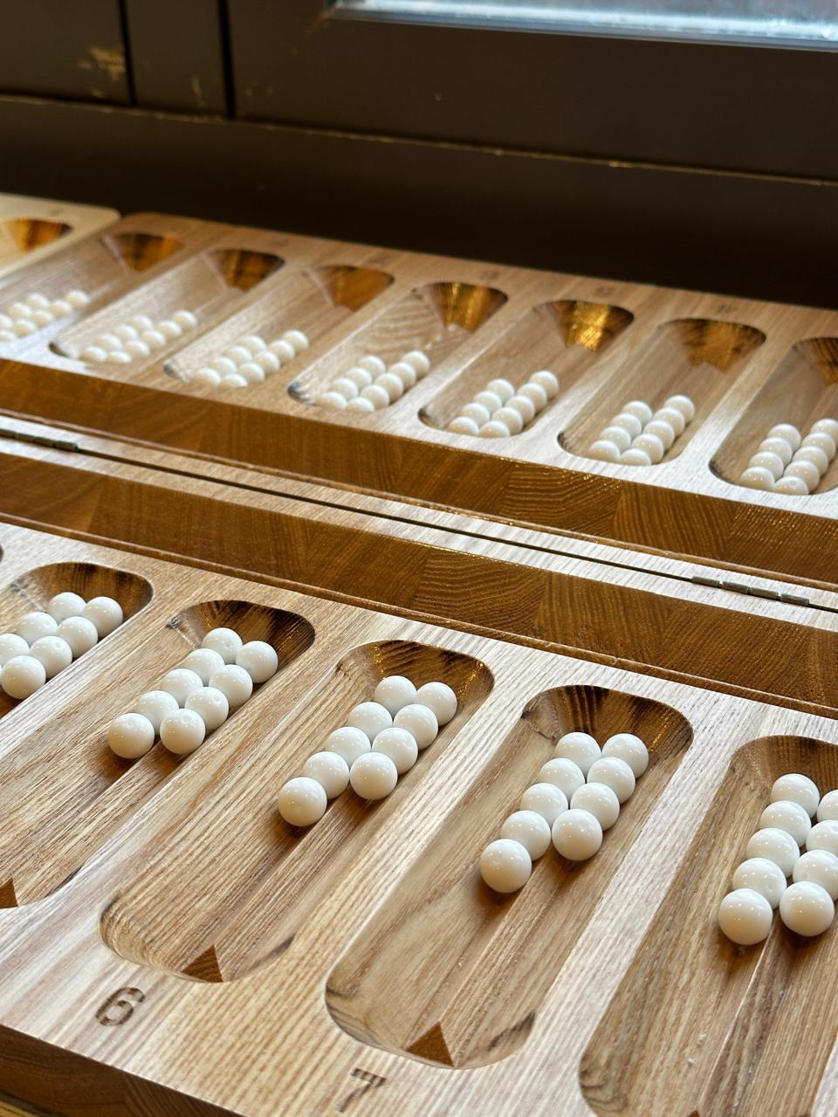
What
TogyzQumalaQ / Toguz korgool
Bestemshe
Kozdatu
Mangala

Slide 4
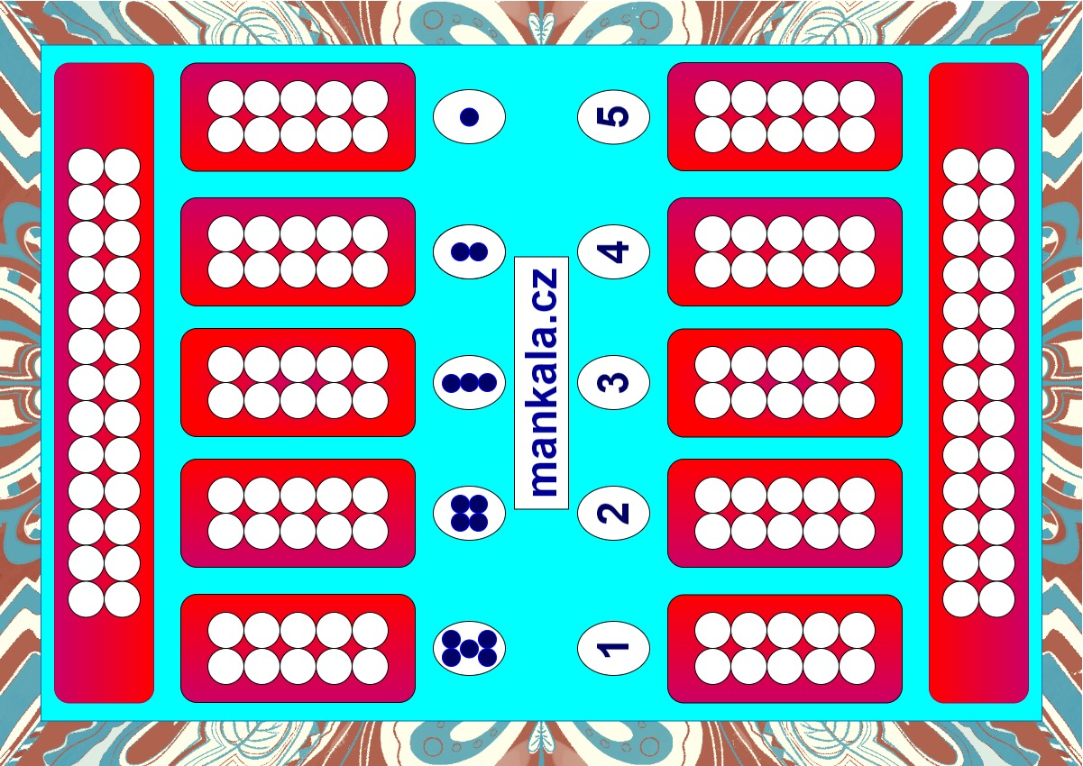
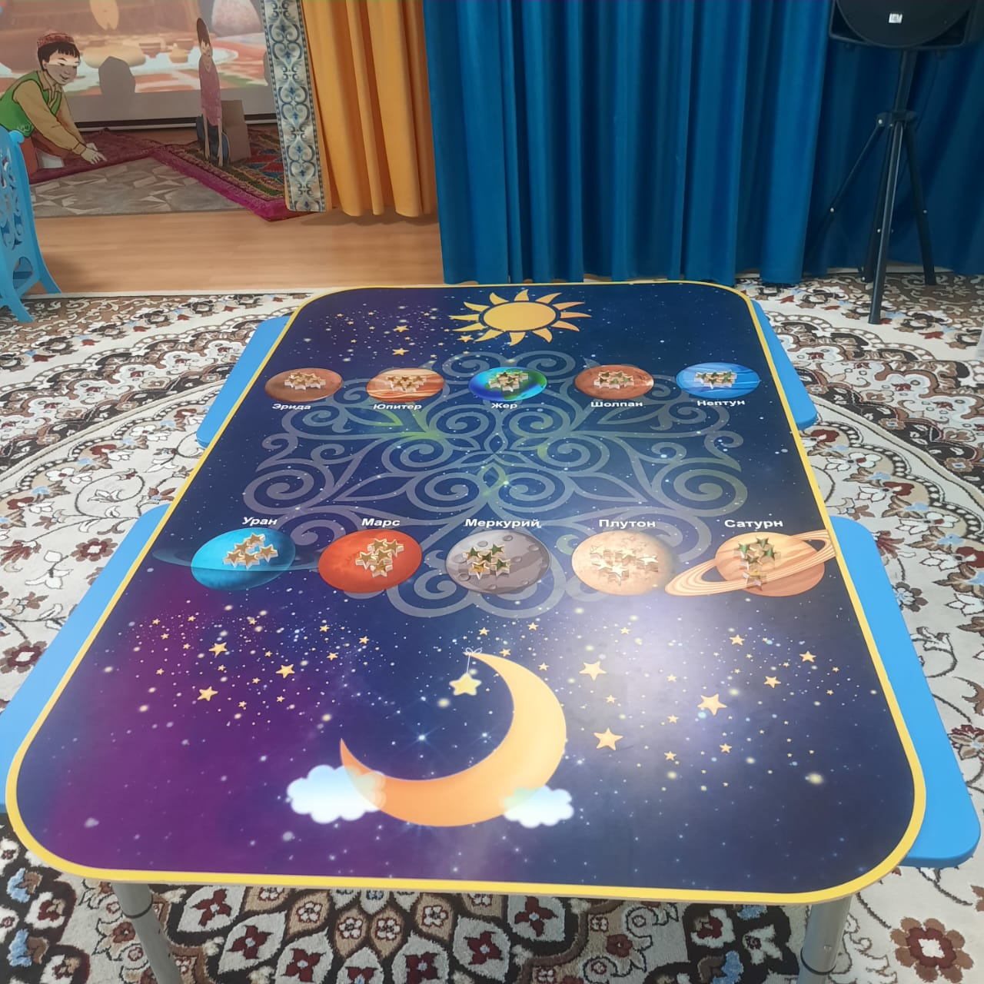
Bestemshe

Slide 5
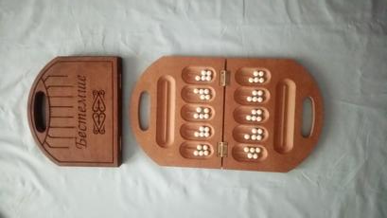
Bestemshe (explanation of rules)

Slide 6
Kozdatu
7 cups, 7 pieces in each cup
You can play with both rules - for Bestemshe or for Toguz

Slide 7
TogyzQumalaQ, Toguz korgool
Toguz = 9
Kumalak / korgool = ball, piece
Kazakhstan – 200 000 active players
Kyrgyzstan – 83 000 active players
(Active players of Chess in Czech Republic – 13 000)

Slide 8
Necessary and sufficient conditions to discover mathematics in game
Tournament board – numbered cups
You feel you do not want to count where you finish with your finger any more
You discover some strategy and you start to count number of moves before you have to sow to opponent’s side of board

Slide 9
First knowledge
Toguz: 10 – 19 – 28
Bestemshe: 6 – 11 – 16
Oware, Mangala = (calculate it)

Slide 10
Where you finish sowing
Cup No. 7 contains 26 pieces. Where you finish sowing of this cup?
1st method – knowledge: 28 go to same cup number as where it is now, on opponent’s side =>
7 – (28-26) = 5
2nd method – you need to see the board - (26-3) mod 9
3rd method – (26+7-1) mod 9
* mod 9 => modulo number of cups on one side of the board

Slide 11
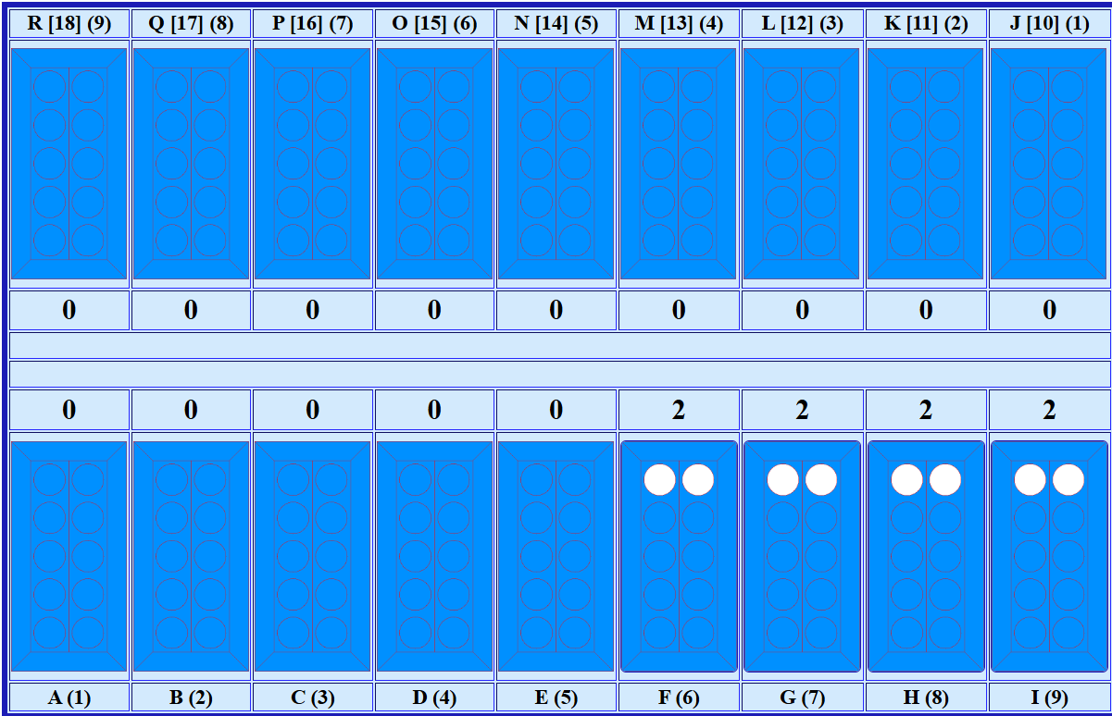
How many moves - basics
Natural use of the board,
where you take a look
to opponent side of board
and you use multiplication
Here 4x3 = 12

Slide 12
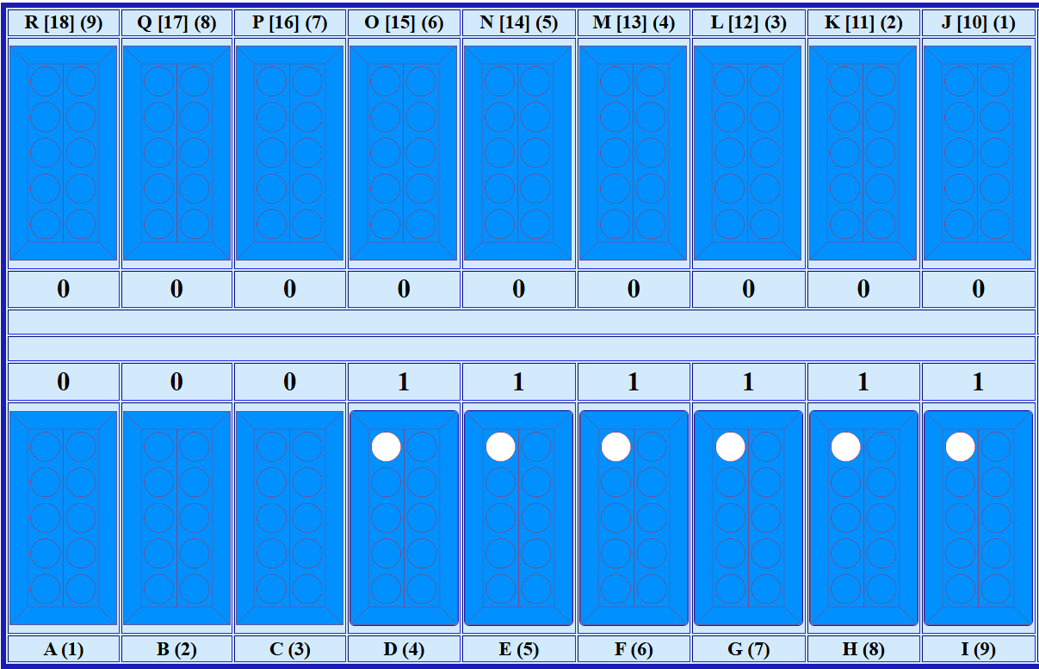
How many moves – basics (2)
Natural use of the board,
where you take a look
to opponent side of board
and you use addition
Here 1+2+3+4+5 = 15

Slide 13
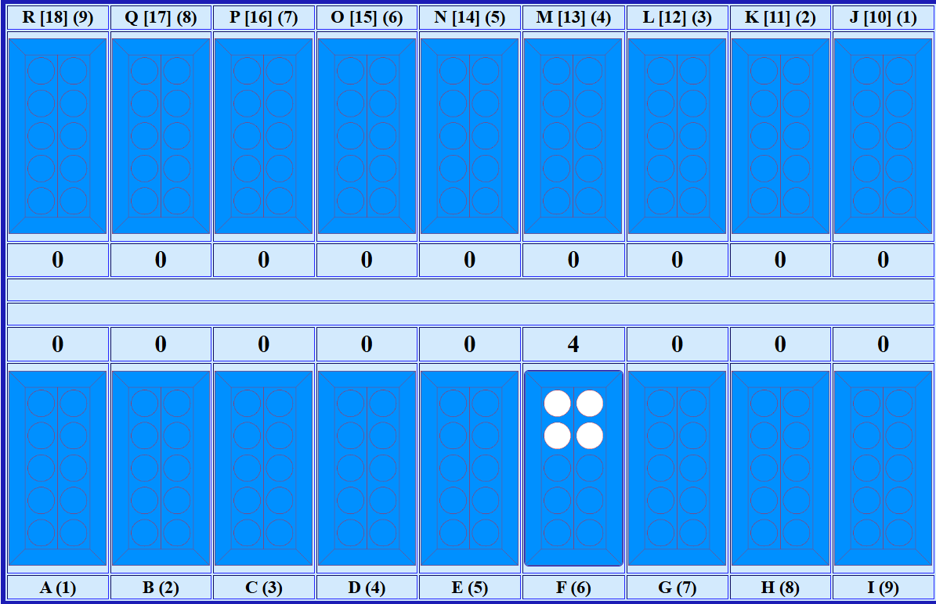
How many moves – advanced
Number of moves – 7 (= 4x3-5)
We count is as 4 (number of pieces in cup) multiplied by 3 (9 minus number of cup we sow from)
[9 = number of cups in row]
Minus constant for number of pieces
3 | 4 | 5 | 6 | 7 | 8
2 | 5 | 9 | 14 | 20 | 27

Slide 14
Didactics
(plan for Czech Republic)
Games with capturing last piece on empty board (suitable for age 3-5 years) – czech experiment 2015-2020
Bestemshe (from age of 5 years) – taught in 1000 Kazakh kindergartens
Abaku (from 1st class) [+ Bestemshe]
Toguz + Abaku

Slide 15



Thank you
8th World Championship is expected during 6th World Nomad Games in Kyrgyzstan in September 2026.

