Slide 1
Bestemshe in education system of Czech Republic development and plans
Hana Kotinova
Czech federation of mancala games
2025

Slide 2
Finding rules – 1991
ISBN: 27-053-86
Olympia, 1986
Miloš Zapletal – teacher and collector of board games
Book contains rules of Togyzqumalaq

Slide 3
Finding game
2006 – Mind Sport Olympiad, London
Meeting of Kazakh players and czech game promoter
2007 – first official tournament in Czech Republic

Slide 4
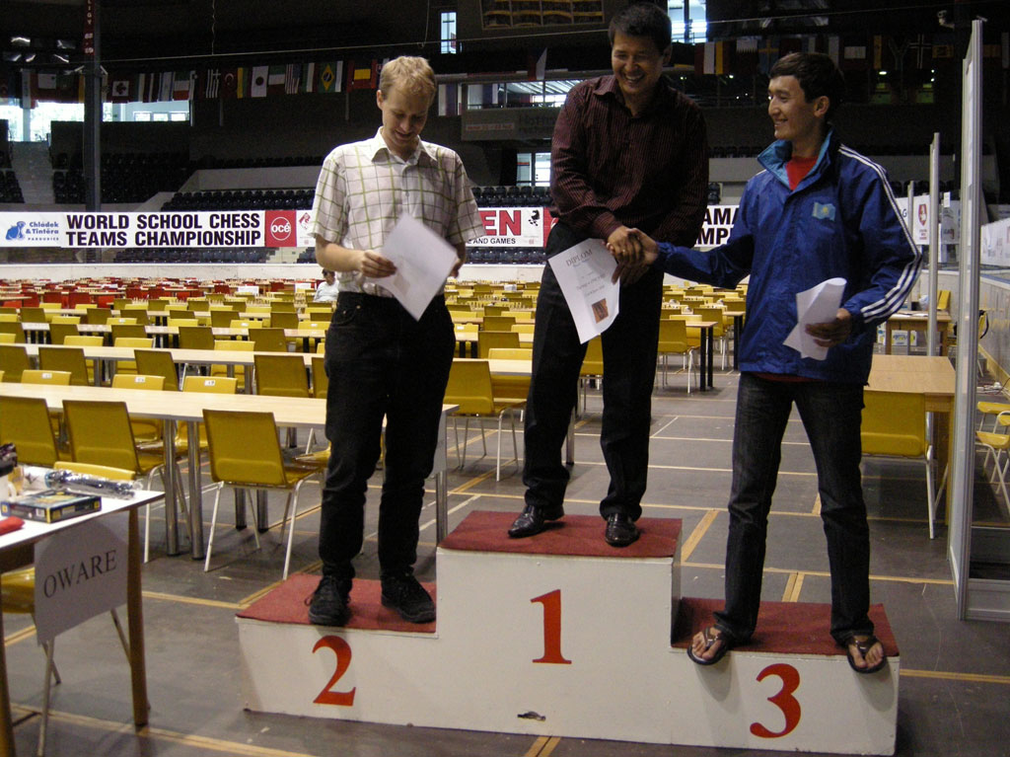
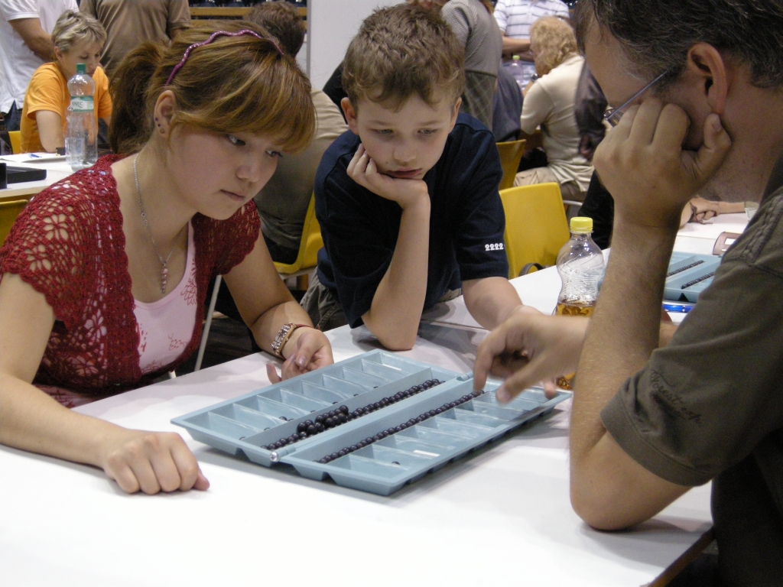
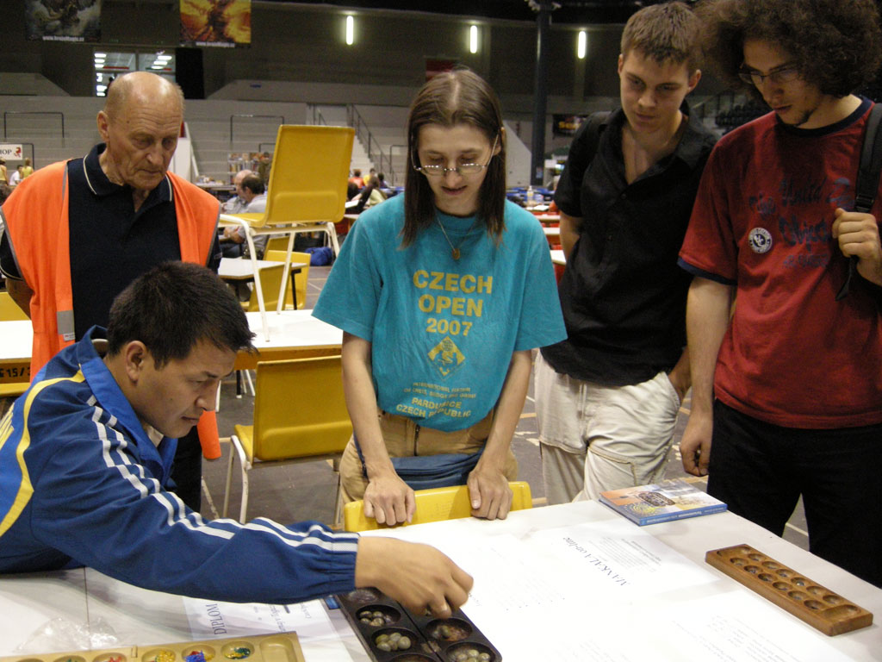
2008 Pardubice
From this year there are 2 internatinal tournaments in Czech Republic every year

Slide 5
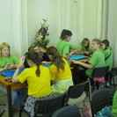
2009
TOGYZQUMALAQ USED DURING SCHOOL PROGRAM AT FESTIVAL DESKOHRANI

Slide 6
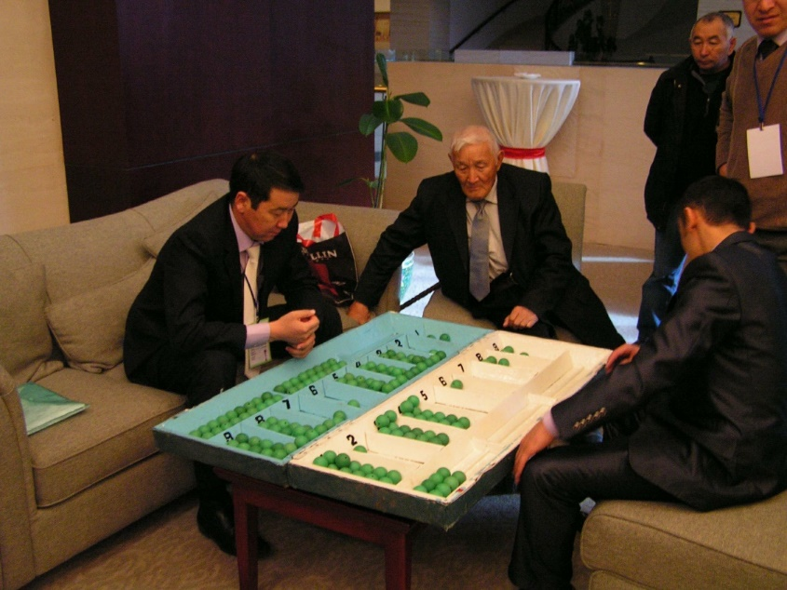
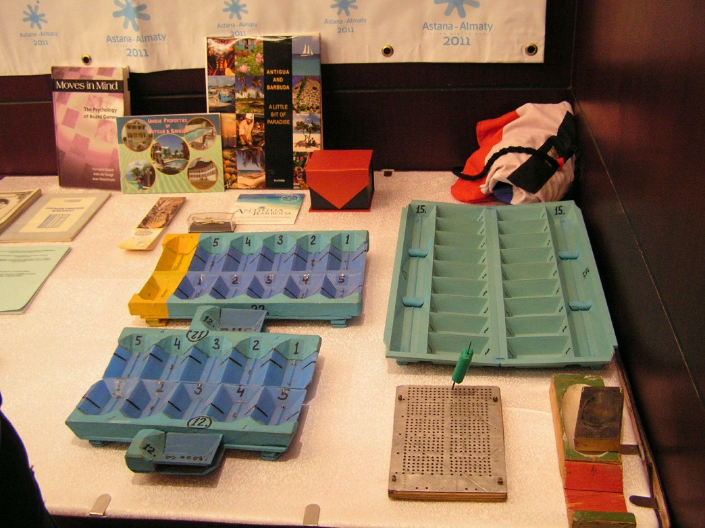
2010 WORLD CHAMPIONSHIP
CZE compete and was asked to organize 1st EU Championship, 2nd World Championship

Slide 7
2011 – HOW TO DO IT ?
First Bestemshe online competiton
http://www.mankala.cz/design2011/souteze2011/ZS1-1kolo.html
1st European Championship, PARDUBICE
Start of the Czech Mancala Federation

Slide 8
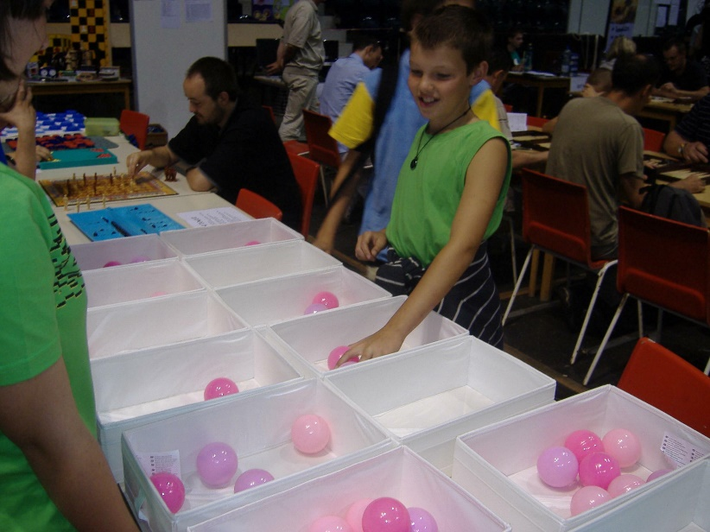
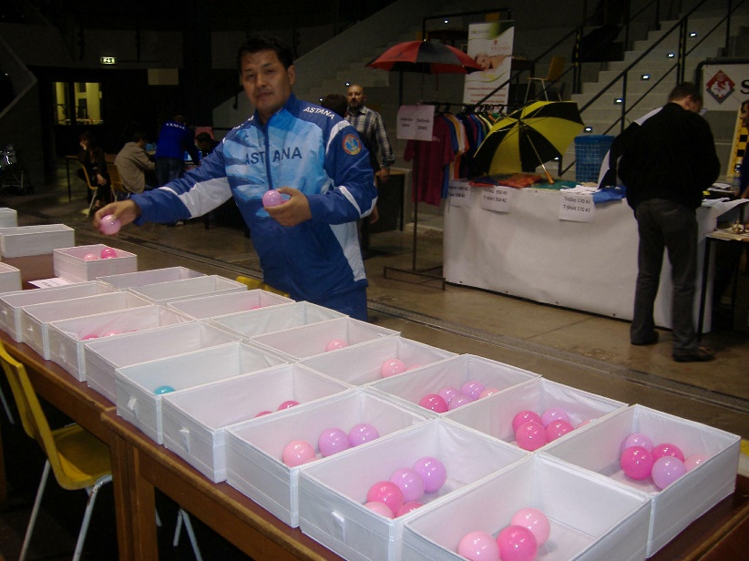
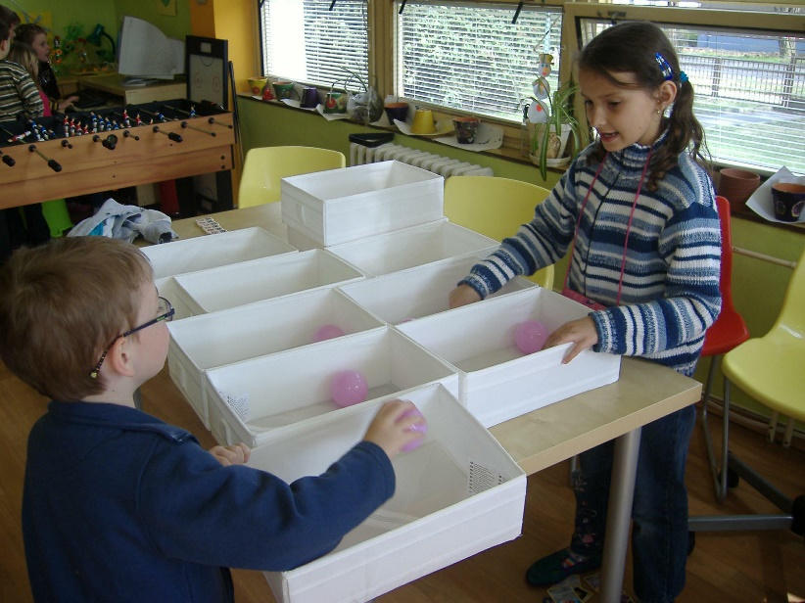
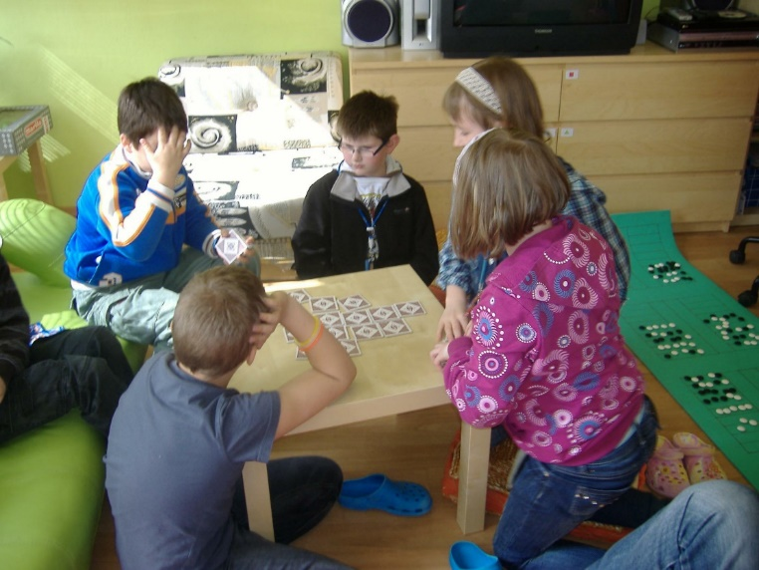
2011 THINKING BIG

Slide 9
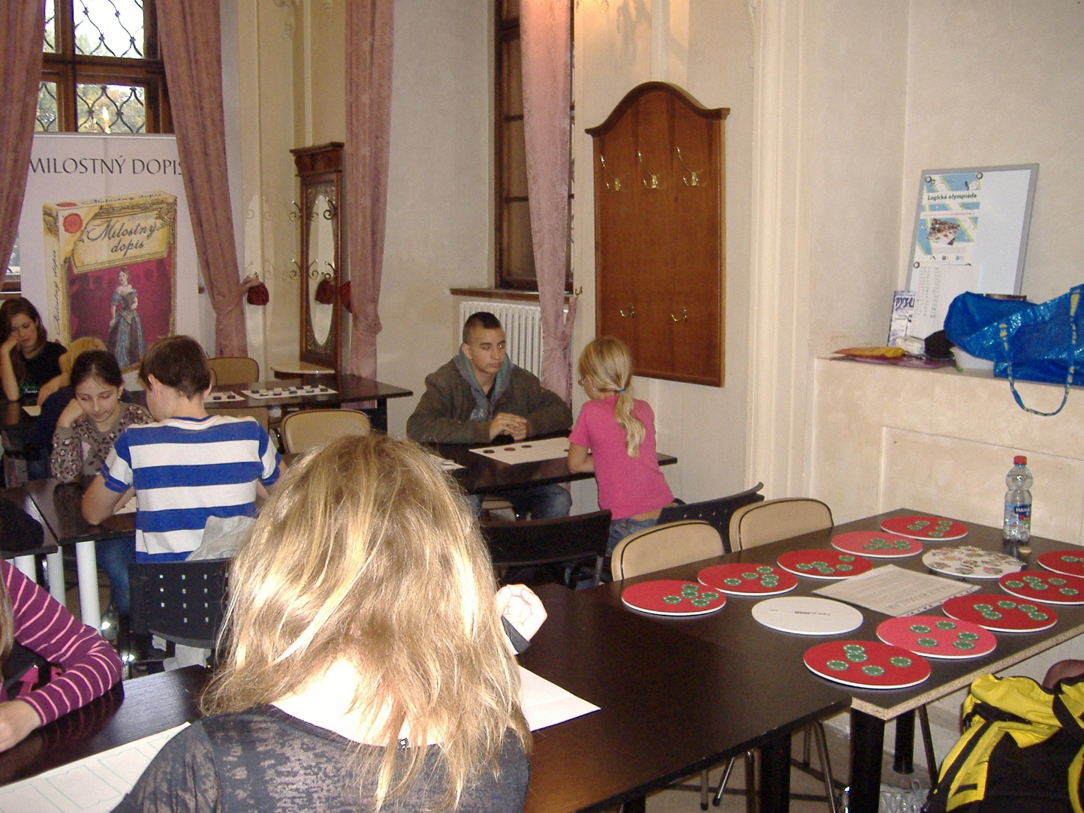
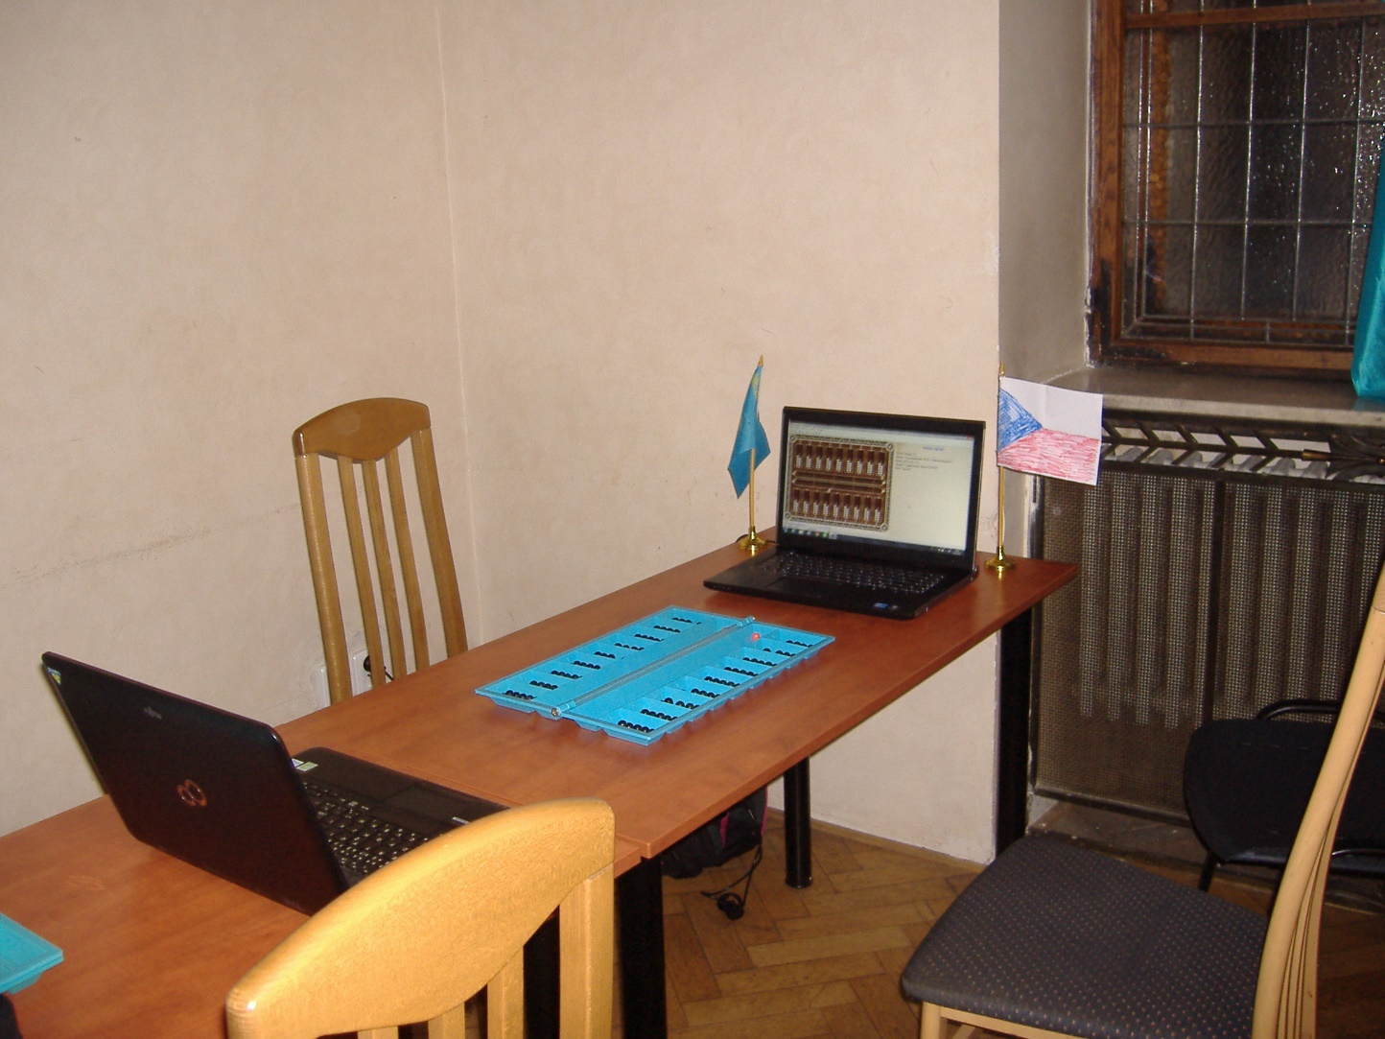
2013 Deskohrani
Bestemshe for schools
1st World Championship for Computers

Slide 10
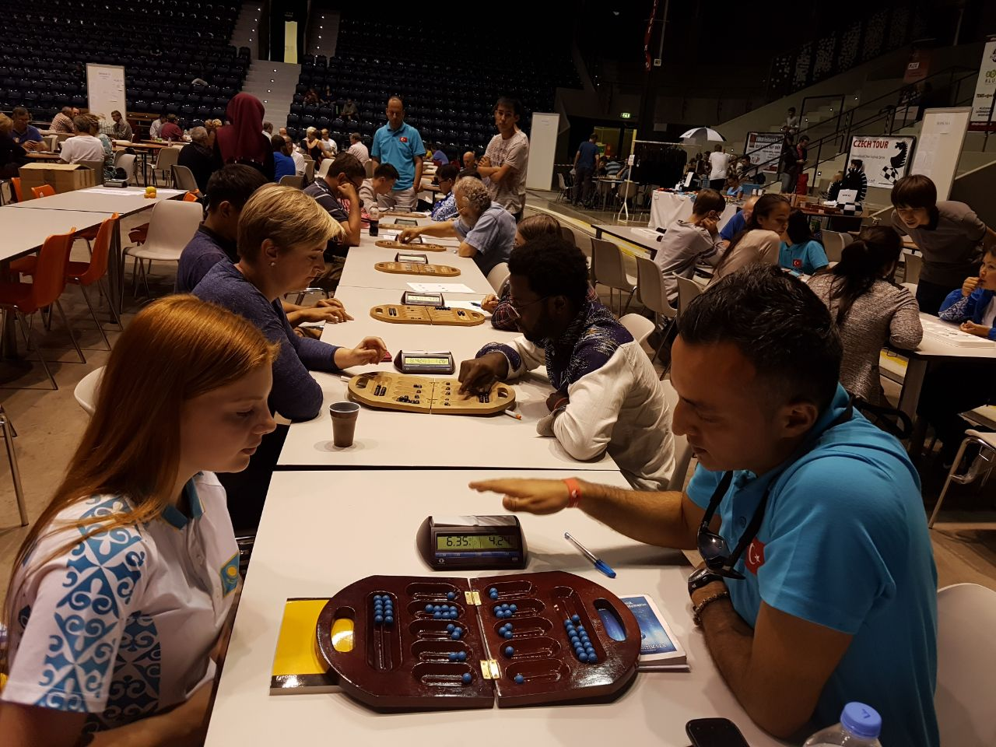
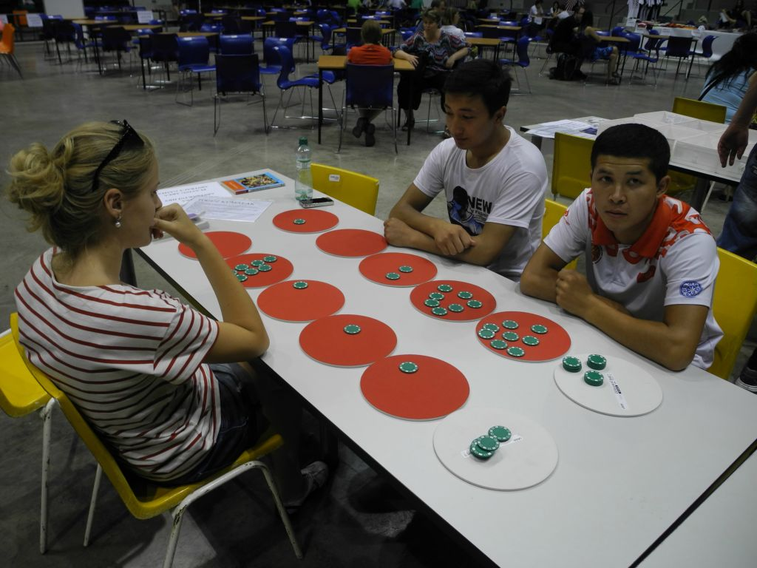
2015 - 1. Bestemshe tournament in pardubice 2017 - new boards for bestemshe

Slide 11
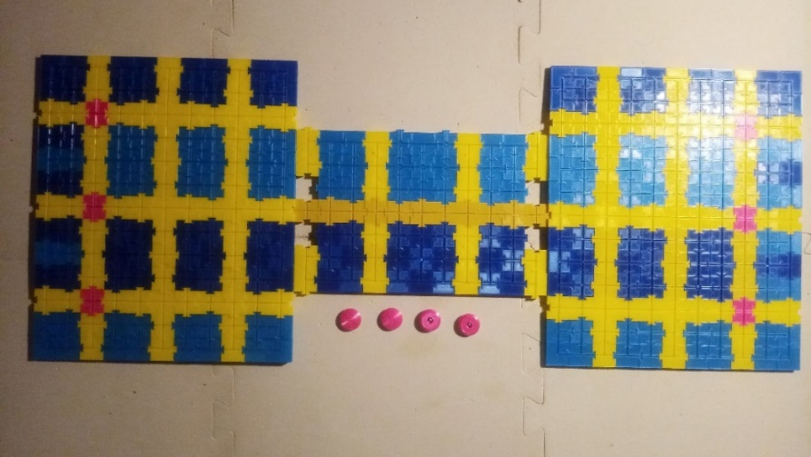
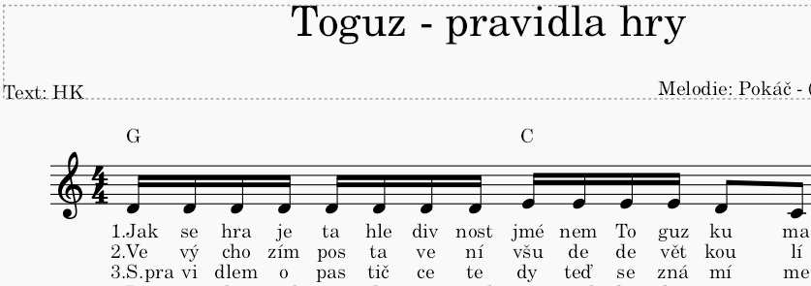
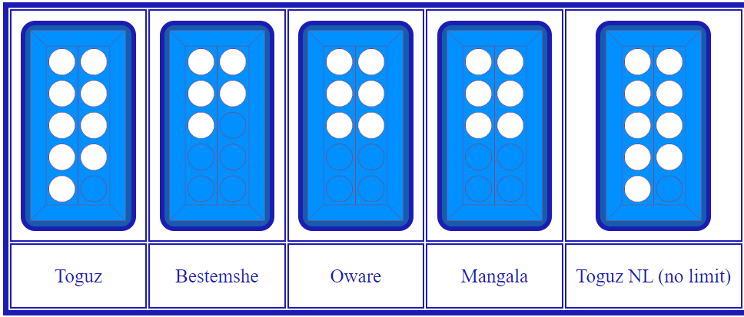
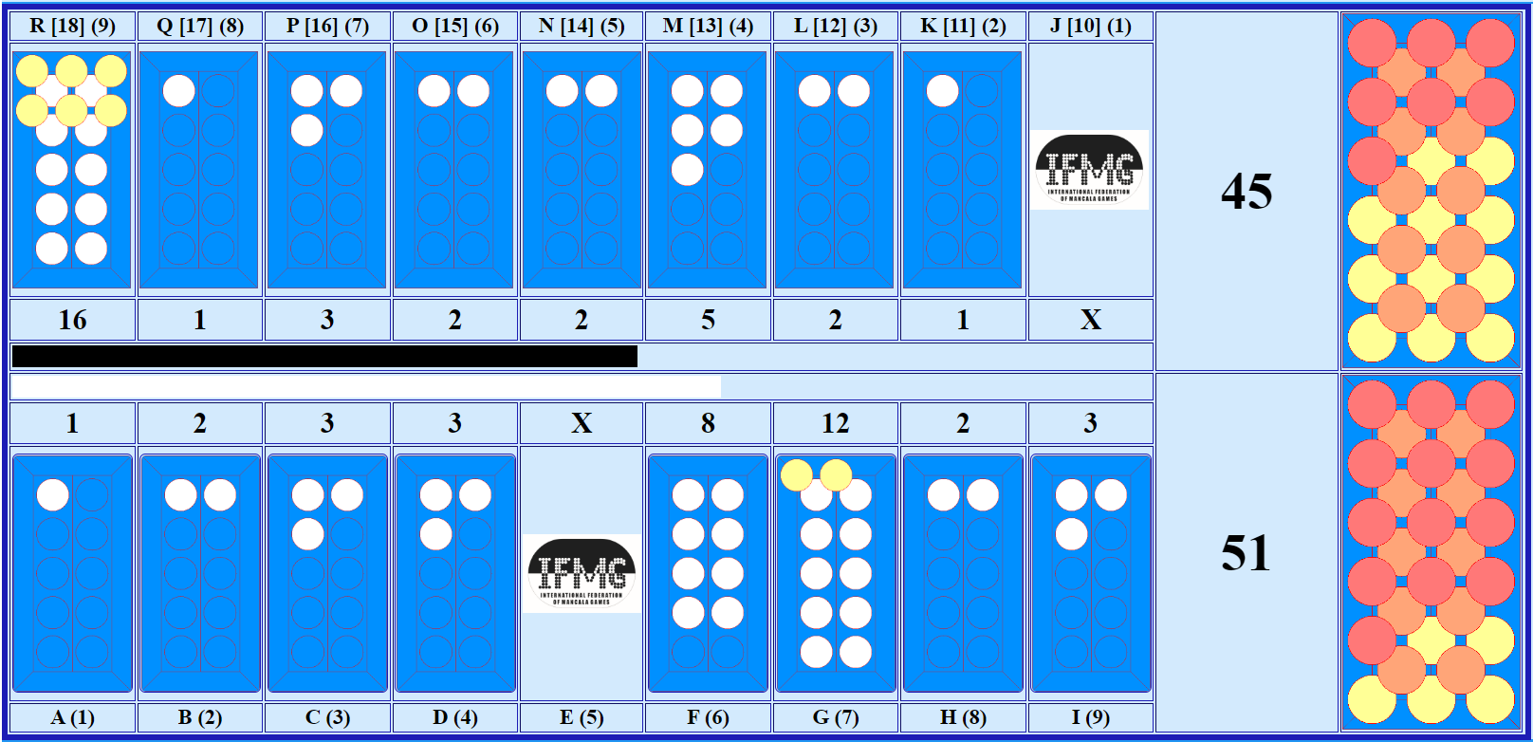
2020 – 2022 creations
Magnetic board (3D print), rules as diagram, rules as song
GAME SERVER – now at MANCALA.CZ

Slide 12
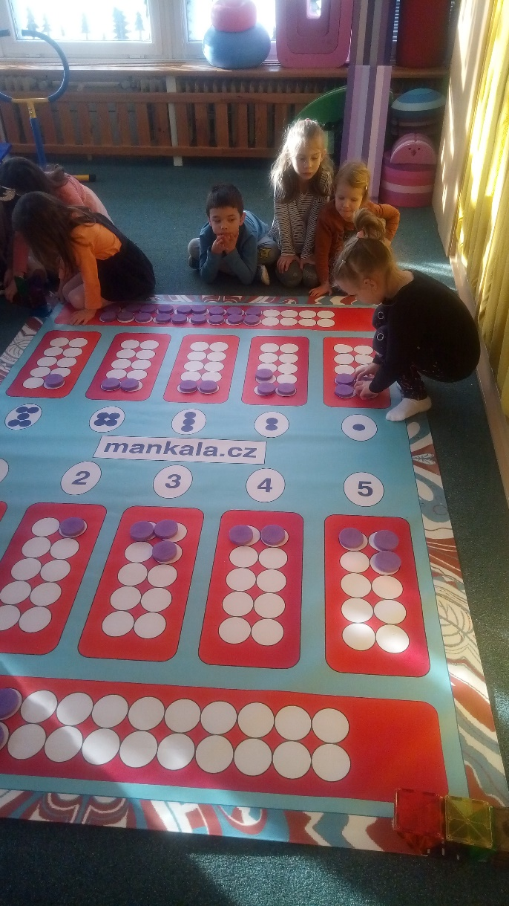
2023 – banner boards 2024 – Bestemshe escape game

Slide 13
ABAKU + BESTEMSHE = GREAT MATHEMATICS
2021-2024 IDEA
IF WE CONNECT BESTEMSHE + ABAKU, no child should be afraid of mathematics
ABAKU.ORG

Slide 14
PARDUBICE 2025 INVITATION
18 JULY – 21 JULY
TOGYZQUMALAQ, OWARE, MANGALA
BESTEMSHE, BAO
17 JULY – 2 AUGUST
Chess and other games, some weekend days presentation of mancala games as well
Full details soon on websites
www.mankala.cz
and
www.czechopen.net

Slide 15
THANK YOU

